Slide 1
Introduction to Differential Equations - Lecture 2
Fei Qi
Email: fei.qi@du.edu
Office Hour: TBA
Website: https://feiqimath.github.io

Slide 2
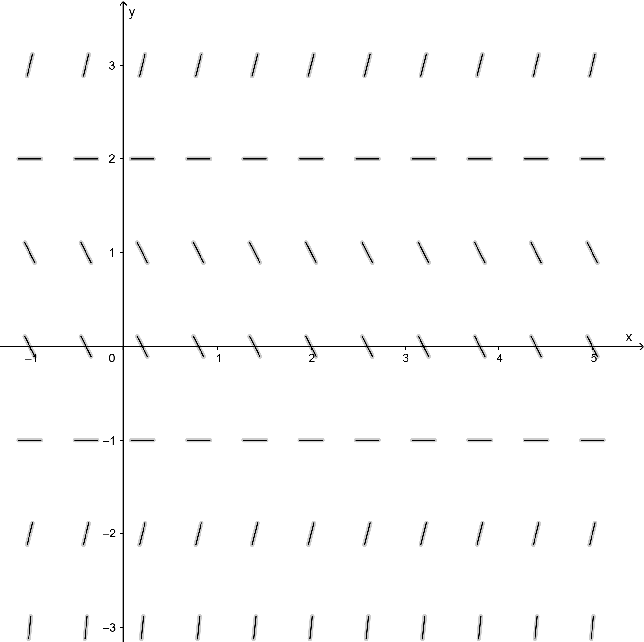
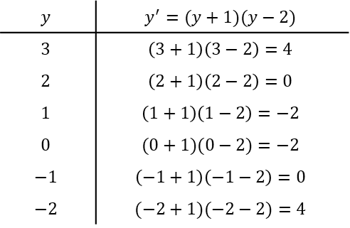
Qualitative method
Example: $y^{′}=(y+1)(y−2)$
$$y$$ | $$y^{′}=(y+1)(y−2)$$
$$3$$ | $$\left(3+1\right)\left(3−2\right)=4$$
$$2$$ | $$\left(2+1\right)\left(2−2\right)=0$$
$$1$$ | $$\left(1+1\right)\left(1−2\right)=−2$$
$$0$$ | $$(0+1)(0−2)=−2$$
$$−1$$ | $$\left(−1+1\right)\left(−1−2\right)=0$$
$$−2$$ | $$(−2+1)(−2−2)=4$$

Slide 3
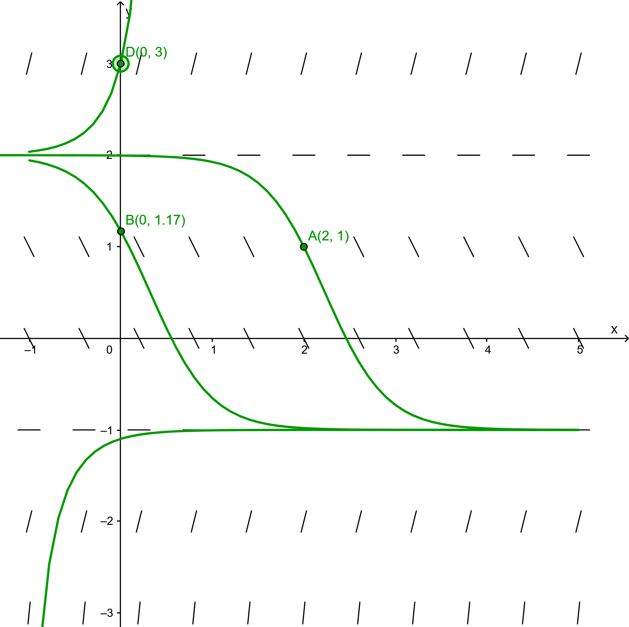

Qualitative method
Example: $y^{′}=(y+1)(y−2)$
Knowing the direction field, we may plot the graph of a few actual solutions on the yt-plane. The graph is usually called an integral curve.
$$y$$ | $$y^{′}=(y+1)(y−2)$$
$$3$$ | $$\left(3+1\right)\left(3−2\right)=4$$
$$2$$ | $$\left(2+1\right)\left(2−2\right)=0$$
$$1$$ | $$\left(1+1\right)\left(1−2\right)=−2$$
$$0$$ | $$(0+1)(0−2)=−2$$
$$−1$$ | $$\left(−1+1\right)\left(−1−2\right)=0$$
$$−2$$ | $$(−2+1)(−2−2)=4$$

Slide 4

Qualitative method
Example: $y^{′}=(y+1)(y−2)$
We may analyze the asymptotic behavior, or long-term behavior, of the solutions, i.e., the behavior of y(t) when $t→±∞$.
If $y\left(t_{0}\right)>2,$
then $\lim_{t→∞}y\left(t\right)=∞,\lim_{t→−∞}y\left(t\right)=2.$
$$y$$ | $$y^{′}=(y+1)(y−2)$$
$$3$$ | $$\left(3+1\right)\left(3−2\right)=4$$
$$2$$ | $$\left(2+1\right)\left(2−2\right)=0$$
$$1$$ | $$\left(1+1\right)\left(1−2\right)=−2$$
$$0$$ | $$(0+1)(0−2)=−2$$
$$−1$$ | $$\left(−1+1\right)\left(−1−2\right)=0$$
$$−2$$ | $$(−2+1)(−2−2)=4$$

Slide 5

Qualitative method
Example: $y^{′}=(y+1)(y−2)$
We may analyze the asymptotic behavior, or long-term behavior, of the solutions, i.e., the behavior of y(t) when $t→±∞$.
If $y\left(t_{0}\right)∈(−1,2),$
then $\lim_{t→∞}y\left(t\right)=2,\lim_{t→−∞}y\left(t\right)=−1.$
$$y$$ | $$y^{′}=(y+1)(y−2)$$
$$3$$ | $$\left(3+1\right)\left(3−2\right)=4$$
$$2$$ | $$\left(2+1\right)\left(2−2\right)=0$$
$$1$$ | $$\left(1+1\right)\left(1−2\right)=−2$$
$$0$$ | $$(0+1)(0−2)=−2$$
$$−1$$ | $$\left(−1+1\right)\left(−1−2\right)=0$$
$$−2$$ | $$(−2+1)(−2−2)=4$$

Slide 6

Qualitative method
Example: $y^{′}=(y+1)(y−2)$
We may analyze the asymptotic behavior, or long-term behavior, of the solutions, i.e., the behavior of y(t) when $t→±∞$.
If $y\left(t_{0}\right)<2,$
then $\lim_{t→∞}y\left(t\right)=2,\lim_{t→−∞}y\left(t\right)=−∞.$
$$y$$ | $$y^{′}=(y+1)(y−2)$$
$$3$$ | $$\left(3+1\right)\left(3−2\right)=4$$
$$2$$ | $$\left(2+1\right)\left(2−2\right)=0$$
$$1$$ | $$\left(1+1\right)\left(1−2\right)=−2$$
$$0$$ | $$(0+1)(0−2)=−2$$
$$−1$$ | $$\left(−1+1\right)\left(−1−2\right)=0$$
$$−2$$ | $$(−2+1)(−2−2)=4$$

Slide 7

Qualitative method
Example: $y^{′}=(y+1)(y−2)$
We may analyze the asymptotic behavior, or long-term behavior, of the solutions, i.e., the behavior of y(t) when $t→±∞$.
If $y\left(t_{0}\right)=2,$ then $y\left(t\right)=2$ for every real number t. So $y\left(t\right)=2$ is an equilibrium solution.
$$y$$ | $$y^{′}=(y+1)(y−2)$$
$$3$$ | $$\left(3+1\right)\left(3−2\right)=4$$
$$2$$ | $$\left(2+1\right)\left(2−2\right)=0$$
$$1$$ | $$\left(1+1\right)\left(1−2\right)=−2$$
$$0$$ | $$(0+1)(0−2)=−2$$
$$−1$$ | $$\left(−1+1\right)\left(−1−2\right)=0$$
$$−2$$ | $$(−2+1)(−2−2)=4$$

Slide 8

Qualitative method
Example: $y^{′}=(y+1)(y−2)$
We may analyze the asymptotic behavior, or long-term behavior, of the solutions, i.e., the behavior of y(t) when $t→±∞$.
If $y\left(t_{0}\right)=0,$ then $y\left(t\right)=0$ for every real number t. So $y\left(t\right)=0$ is an equilibrium solution.
$$y$$ | $$y^{′}=(y+1)(y−2)$$
$$3$$ | $$\left(3+1\right)\left(3−2\right)=4$$
$$2$$ | $$\left(2+1\right)\left(2−2\right)=0$$
$$1$$ | $$\left(1+1\right)\left(1−2\right)=−2$$
$$0$$ | $$(0+1)(0−2)=−2$$
$$−1$$ | $$\left(−1+1\right)\left(−1−2\right)=0$$
$$−2$$ | $$(−2+1)(−2−2)=4$$

Slide 9
What happens if the ODE involves t
It is still possible to draw the direction field by hand and use the qualitative method to analyze the asymptotic behavior of the solutions.
We will not require the technique in this course.
Please watch MIT Lecture 1 if you are interested:
https://ocw.mit.edu/courses/18-03-differential-equations-spring-2010/resources/lecture-1-the-geometrical-view-of-y-f-x-y/

Slide 10

Classification of Differential Equations
We saw in the last lecture that differential equations can be classified by
Types: ODE and PDE.
Order: the order of highest derivative.
Today: Linearity.
In this course, we mainly focus on linear ODEs, i.e.,
$$F\left(t,y,y^{′},…,y^{(n)}\right)=0,$$
where F is linear in $y,y^{′},…,y^{(n)}$. Equivalently, all $\frac{∂F}{∂y^{(i)}}$ depend only on t and does not depend on $y,y^{′},…,y^{(n)}$. Otherwise, we say the ODE is nonlinear.

Slide 11

Classification of Differential Equations
In this course, we mainly focus on linear ODEs, i.e.,
$$F\left(t,y,y^{′},…,y^{(n)}\right)=0,$$
where F is linear in $y,y^{′},…,y^{(n)}$. Equivalently, all $\frac{∂F}{∂y^{(i)}}$ depend only on t and does not depend on $y,y^{′},…,y^{(n)}$. Otherwise, we say the ODE is nonlinear.
Reminder: Given an n-variable function $F\left(x_{1},…, x_{n}\right)$, the partial derivative $\frac{∂F}{∂x_{i}}$ is obtained by taking the derivative with respect to $x_{i}$ while treating all other $x_{j}$’s as constants.
Example: $F\left(x,y\right)=x^{2}+y^{2}$, then $\frac{∂F}{∂x}=2x$, $\frac{∂F}{∂y}=2y$.
$F\left(x,y\right)=\sqrt{x^{2}+y^{2}}$, then $\frac{∂F}{∂x}=\frac{x}{\sqrt{x^{2}+y^{2}}}$, $\frac{∂F}{∂y}=\frac{y}{\sqrt{x^{2}+y^{2}}}$.

Slide 12
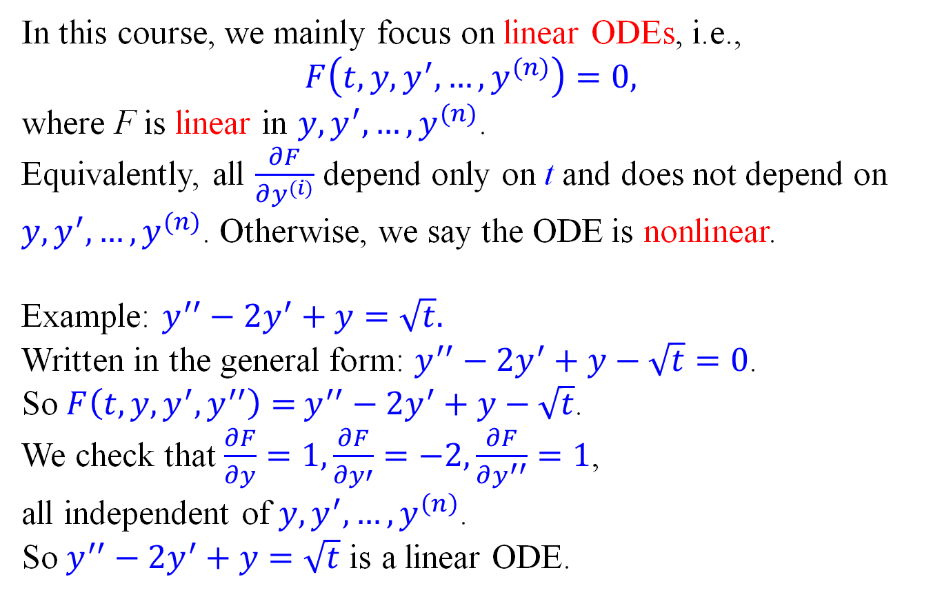
Classification of Differential Equations
In this course, we mainly focus on linear ODEs, i.e.,
$$F\left(t,y,y^{′},…,y^{(n)}\right)=0,$$
where F is linear in $y,y^{′},…,y^{(n)}$. Equivalently, all $\frac{∂F}{∂y^{(i)}}$ depend only on t and does not depend on $y,y^{′},…,y^{(n)}$. Otherwise, we say the ODE is nonlinear.
Example: $y^{′′}−2y^{′}+y=\sqrt{t}.$
Written in the general form: $y^{′′}−2y^{′}+y−\sqrt{t}=0$.
So $F\left(t,y,y^{′},y^{′′}\right)=$ $y^{′′}−2y^{′}+y−\sqrt{t}$.
We check that $\frac{∂F}{∂y}=1,\frac{∂F}{∂y′}=−2,\frac{∂F}{∂y^{′′}}=1$,
all independent of $y,y^{′},…,y^{\left(n\right)}$.
So $y^{′′}−2y^{′}+y=\sqrt{t}$ is a linear ODE.

Slide 13
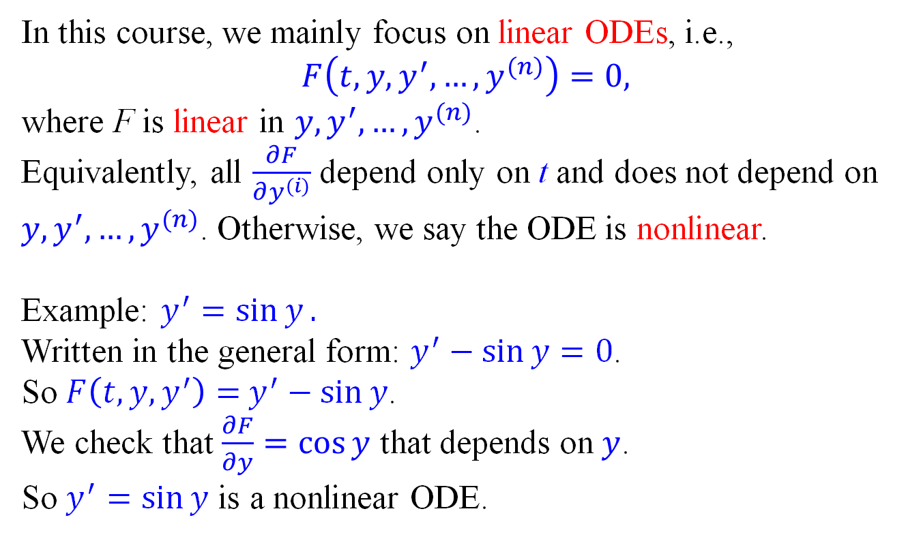
Classification of Differential Equations
In this course, we mainly focus on linear ODEs, i.e.,
$$F\left(t,y,y^{′},…,y^{(n)}\right)=0,$$
where F is linear in $y,y^{′},…,y^{(n)}$. Equivalently, all $\frac{∂F}{∂y^{(i)}}$ depend only on t and does not depend on $y,y^{′},…,y^{(n)}$. Otherwise, we say the ODE is nonlinear.
Example: $y^{′}=\sin{y}.$
Written in the general form: $y^{′}−\sin{y}=0$.
So $F\left(t,y,y^{′}\right)=$ $y^{′}−\sin{y}$.
We check that $\frac{∂F}{∂y}=\cos{y}$ that depends on $y$.
So $y^{′}=\sin{y}$ is a nonlinear ODE.

Slide 14

Classification of Differential Equations
In this course, we mainly focus on linear ODEs, i.e.,
$$F\left(t,y,y^{′},…,y^{(n)}\right)=0,$$
where F is linear in $y,y^{′},…,y^{(n)}$. Equivalently, all $\frac{∂F}{∂y^{(i)}}$ depend only on t and does not depend on $y,y^{′},…,y^{(n)}$. Otherwise, we say the ODE is nonlinear.
Example: $y^{′′}−\sqrt{t}y^{′}+\sin{{(t}^{2})}y=t^{3}.$
Written in the general form:$y^{′′}−\sqrt{t}y^{′}+\sin{{(t}^{2})}y−t^{3}=0$.
So $F\left(t,y,y^{′},y^{′′}\right)=y^{′′}−\sqrt{t}y^{′}+\sin{{(t}^{2})}y−t^{3}$.
We check that $\frac{∂F}{∂y^{′′}}=1,\frac{∂F}{∂y′}=−\sqrt{t},\frac{∂F}{∂y}=\sin\left(t^{2}\right)$,
all independent of $y,y^{′},…,y^{\left(n\right)}$.
So$y^{′′}−\sqrt{t}y^{′}+\sin{{(t}^{2})}y=t^{3}$is a linear ODE.

Slide 15

Classification of Differential Equations
In this course, we mainly focus on linear ODEs, i.e.,
$$F\left(t,y,y^{′},…,y^{(n)}\right)=0,$$
where F is linear in $y,y^{′},…,y^{(n)}$. Equivalently, all $\frac{∂F}{∂y^{(i)}}$ depend only on t and does not depend on $y,y^{′},…,y^{(n)}$. Otherwise, we say the ODE is nonlinear.
Generally, every nth order linear ODE can be written as
$$y^{(n)}+a_{1}\left(t\right)y^{(n−1)}+⋯+a_{n−1}\left(t\right)y^{′}+a_{n}\left(t\right)y=g\left(t\right).$$
This is the standard form of a linear ODE (where the coefficient of the highest derivative is 1).
We know a lot about linear ODEs, but very little about nonlinear ODEs.

Slide 16

First-order linear ODEs - Formula
Standard form:
$$y^{′}+p\left(t\right)y=g\left(t\right).$$
Integrating factor:
$$μ\left(t\right)=e^{∫p\left(t\right)dt}.$$
General solution:
$$y\left(t\right)=\frac{\int{μ\left(t\right)g\left(t\right)dt}+C}{μ(t)}$$
How comes the formula? Observe that
$$e^{∫p\left(t\right)dt}\left(y^{′}+p\left(t\right)y\right)=\left(e^{∫p\left(t\right)dt}y\right)′.$$
In general, any function $μ\left(t\right)$ making
$$μ\left(t\right)\left(y′(t)+p\left(t\right)y(t)\right)=\left(μ\left(t\right)y\left(t\right)\right)′$$
is called an integrating factor.

Slide 17

First-order linear ODEs - Integrating factor
How comes the formula? Observe that
$$e^{∫p\left(t\right)dt}\left(y^{′}+p\left(t\right)y\right)=\left(e^{∫p\left(t\right)dt}y\right)′.$$
In general, any function $μ\left(t\right)$ making
$$μ\left(t\right)\left(y′(t)+p\left(t\right)y(t)\right)=\left(μ\left(t\right)y\left(t\right)\right)′$$
is called an integrating factor. To satisfy this equation, we calculate that
$$RHS=μ^{′}\left(t\right)y\left(t\right)+μ\left(t\right)y^{′}\left(t\right)$$
So LHS = RHS means
$$μ\left(t\right)y^{′}\left(t\right)+μ\left(t\right)p\left(t\right)y\left(t\right)=μ^{′}\left(t\right)y\left(t\right)+μ\left(t\right)y^{′}\left(t\right) \\ ⇒μ\left(t\right)p\left(t\right)y\left(t\right)=μ^{′}\left(t\right)y\left(t\right)⇒μ^{′}\left(t\right)=μ\left(t\right)p(t) \\ ⇒\frac{μ^{′}\left(t\right)}{μ(t)}=p\left(t\right)⇒\ln\left|μ\left(t\right)\right|=\int{p\left(t\right)dt} \\ ⇒μ\left(t\right)=e^{∫p\left(t\right)dt}.$$

Slide 18

First-order linear ODEs - General solution
Now that we found the $μ\left(t\right)$
$$μ\left(t\right)\left(y′(t)+p\left(t\right)y(t)\right)=\left(μ\left(t\right)y\left(t\right)\right)′$$
Recall that the ODE we intend to solve is
$$y^{′}\left(t\right)+p\left(t\right)y\left(t\right)=g\left(t\right) \\ ⇒μ\left(t\right)\left(y^{′}\left(t\right)+p\left(t\right)y\left(t\right)\right)=μ\left(t\right)g(t)$$
Thus, we conclude that
$${\left(μ\left(t\right)y\left(t\right)\right)}^{′}=μ\left(t\right)g\left(t\right).$$
Integrate both sides:
$$μ\left(t\right)y\left(t\right)=\int{μ\left(t\right)g\left(t\right)dt}+C \\ ⇒y\left(t\right)=\frac{\int{μ\left(t\right)g\left(t\right)dt}+C}{μ(t)}$$
they shall be equal!

Slide 19

First-order linear ODEs - Remarks
Standard form:$y^{′}+p\left(t\right)y=g\left(t\right).$
Integrating factor: $μ\left(t\right)=e^{∫p\left(t\right)dt}.$
General solution: $y\left(t\right)=\frac{\int{μ\left(t\right)g\left(t\right)dt}+C}{μ(t)}$
Remarks:
This formula ONLY works for the standard form. Before using it, get the standard form first.
When integrating $p\left(t\right)$, no need to worry about the constant or the absolute value. They make no difference.
The arbitrary constant in the general solution appears as a part of the numerator, not outside of the fraction. It is very rare that C is a pure constant.

Slide 20

First-order linear ODEs - Example 1
Standard form:$y^{′}+p\left(t\right)y=g\left(t\right).$
Integrating factor: $μ\left(t\right)=e^{∫p\left(t\right)dt}.$
General solution: $y\left(t\right)=\frac{\int{μ\left(t\right)g\left(t\right)dt}+C}{μ(t)}$
Example 1: $y^{′}+2y=e^{3t}, y\left(0\right)=3.$
Already in standard form.
Integrating factor: $μ\left(t\right)=e^{∫2dt}=e^{2t}=e^{2t}$.
General solution:
$$y\left(t\right)=\frac{\int{e^{2t}e^{3t}dt}+C}{e^{2t}}=\frac{\int{e^{5t}dt}+C}{e^{2t}}=\frac{\frac{1}{5}e^{5t}+C}{e^{2t}} \\ =\frac{1}{5}e^{3t}+Ce^{−2t}.$$

Slide 21

First-order linear ODEs - Example 1
Standard form:$y^{′}+p\left(t\right)y=g\left(t\right).$
Integrating factor: $μ\left(t\right)=e^{∫p\left(t\right)dt}.$
General solution: $y\left(t\right)=\frac{\int{μ\left(t\right)g\left(t\right)dt}+C}{μ(t)}$
Example 1: $y^{′}+2y=e^{3t}, y\left(0\right)=3.$
What if we keep the constant in the integrating factor?
Integrating factor: $μ\left(t\right)=e^{∫2dt+D}=e^{2t+D}=e^{2t}e^{D}$.
General solution:
$$y\left(t\right)=\frac{\int{e^{2t}e^{3t}e^{D}dt}+C}{e^{2t}e^{D}}=\frac{\int{e^{5t}e^{D}dt}+C}{e^{2t}e^{D}}=\frac{\frac{1}{5}e^{5t}+C}{e^{2t}} \\ =\frac{1}{5}e^{3t}+Ce^{−2t}.$$
Nothing really changed!

Slide 22
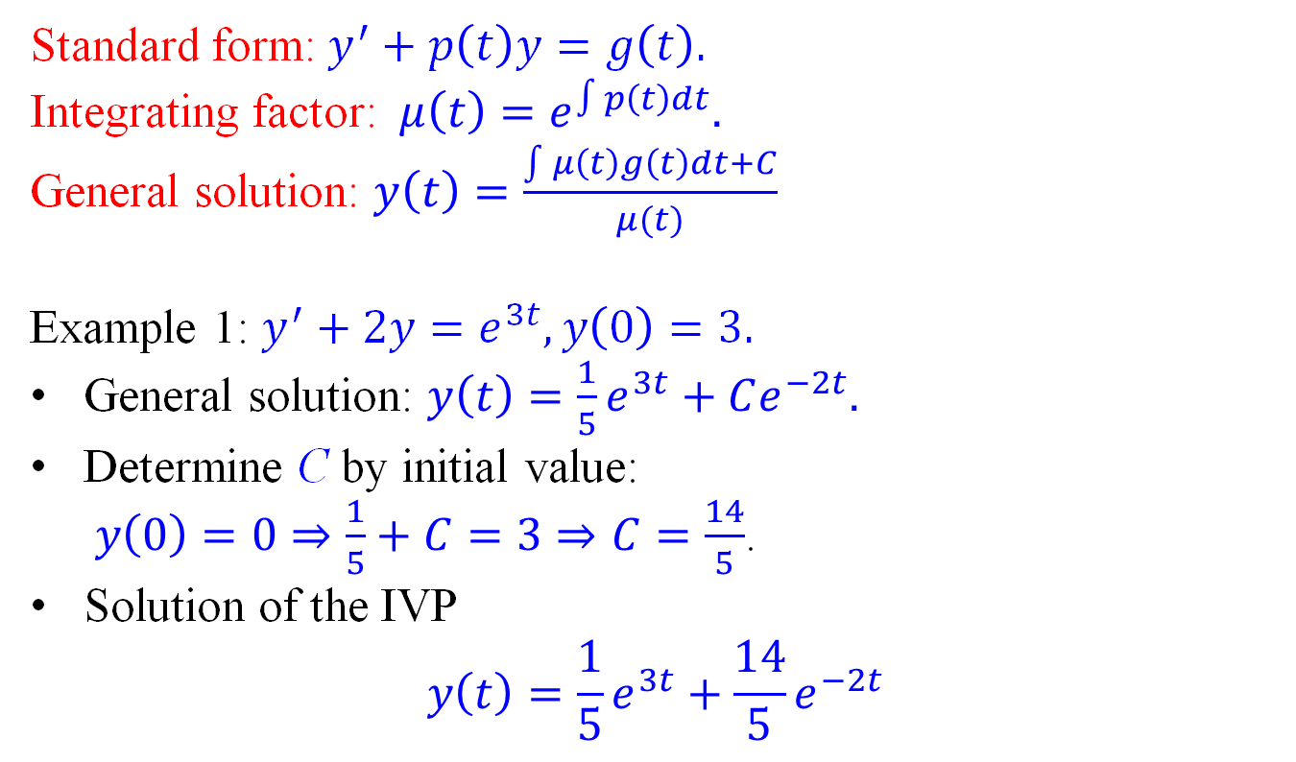
First-order linear ODEs - Example 1
Standard form:$y^{′}+p\left(t\right)y=g\left(t\right).$
Integrating factor: $μ\left(t\right)=e^{∫p\left(t\right)dt}.$
General solution: $y\left(t\right)=\frac{\int{μ\left(t\right)g\left(t\right)dt}+C}{μ(t)}$
Example 1: $y^{′}+2y=e^{3t}, y\left(0\right)=3.$
General solution: $y\left(t\right)=\frac{1}{5}e^{3t}+Ce^{−2t}.$
Determine C by initial value: $y\left(0\right)=0⇒\frac{1}{5}+C=3⇒C=\frac{14}{5}$.
Solution of the IVP $y\left(t\right)=\frac{1}{5}e^{3t}+\frac{14}{5}e^{−2t}$

Slide 23


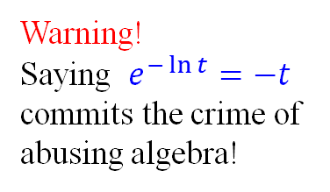
First-order linear ODEs - Example 2
Standard form:$y^{′}+p\left(t\right)y=g\left(t\right).$
Integrating factor: $μ\left(t\right)=e^{∫p\left(t\right)dt}.$
General solution: $y\left(t\right)=\frac{\int{μ\left(t\right)g\left(t\right)dt}+C}{μ(t)}$
Example 2: ${ty}^{′}−y=t^{3}, y\left(1\right)=0.$
Standard form: $y^{′}−\frac{1}{t}y=t^{2}$.
Integrating factor: $μ\left(t\right)=e^{−\int{\frac{1}{t}}dt}=e^{−\ln{|t|}}=\frac{1}{t}$.
General solution:
Warning!
Saying $e^{−\ln{t}}=−t$ commits the crime of abusing algebra!
$$y\left(t\right)=\frac{\int{\frac{1}{t}⋅t^{2}dt}+C}{\frac{1}{t}}=t\left(\int{tdt}+C\right) \\ =t\left(\frac{1}{2}t^{2}+C\right)=\frac{1}{2}t^{3}+Ct.$$

Slide 24
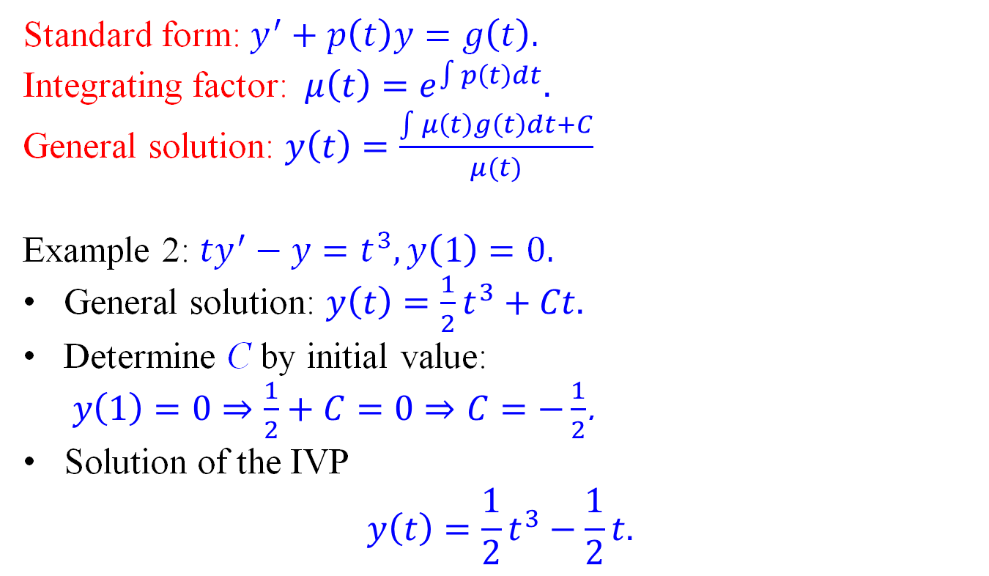
First-order linear ODEs - Example 2
Standard form:$y^{′}+p\left(t\right)y=g\left(t\right).$
Integrating factor: $μ\left(t\right)=e^{∫p\left(t\right)dt}.$
General solution: $y\left(t\right)=\frac{\int{μ\left(t\right)g\left(t\right)dt}+C}{μ(t)}$
Example 2: ${ty}^{′}−y=t^{3}, y\left(1\right)=0.$
General solution: $y\left(t\right)=\frac{1}{2}t^{3}+Ct.$
Determine C by initial value: $y\left(1\right)=0⇒\frac{1}{2}+C=0⇒C=−\frac{1}{2}$.
Solution of the IVP $y\left(t\right)=\frac{1}{2}t^{3}−\frac{1}{2}t.$

Slide 25


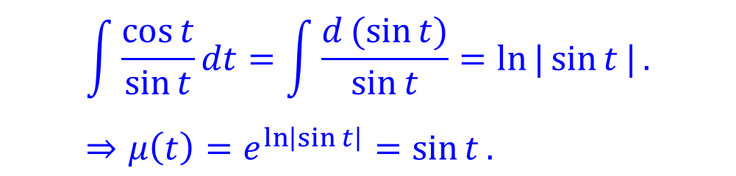
First-order linear ODEs - Example 3
Standard form:$y^{′}+p\left(t\right)y=g\left(t\right).$
Integrating factor: $μ\left(t\right)=e^{∫p\left(t\right)dt}.$
General solution: $y\left(t\right)=\frac{\int{μ\left(t\right)g\left(t\right)dt}+C}{μ(t)}$
Example 3: ${(sin{t)}y}^{′}+\left(\cos{t}\right)y=\sin^{2}{t}, 0<t<π.$
Standard form: $y^{′}+\frac{\cos{t}}{\sin{t}}y=\sin{t}$.
Integrating factor: $μ\left(t\right)=e^{\int{\frac{\cos{t}}{\sin{t}}}dt}$
$$\int{\frac{\cos{t}}{\sin{t}}dt}=\int{\frac{d(sin{t})}{\sin{t}}=\ln{|\sin{t}|}}. \\ ⇒μ\left(t\right)=e^{\ln\left|\sin{t}\right|}=\sin{t}.$$
When $0<t<π,\sin{t}>0, \left|\sin{t}\right|=\sin{t}$

Slide 26
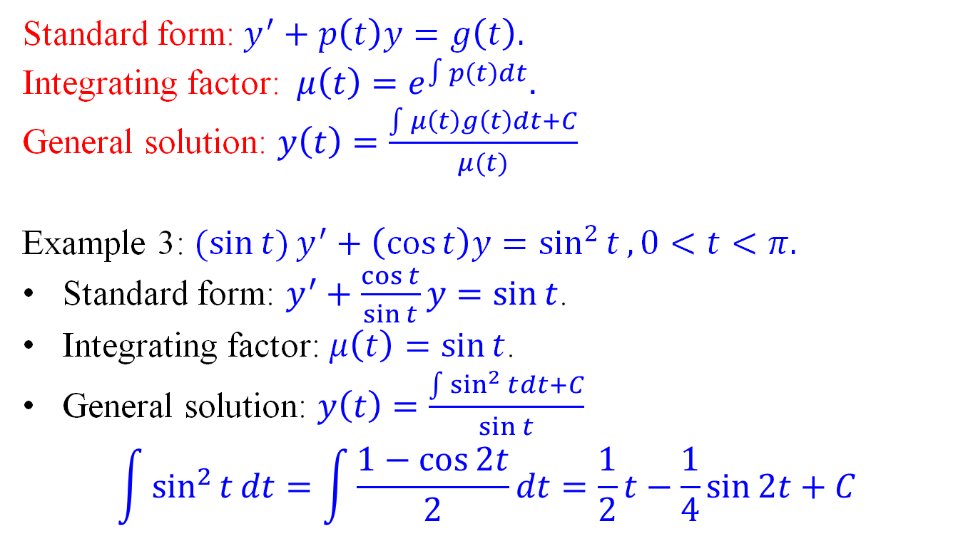
First-order linear ODEs - Example 3
Standard form:$y^{′}+p\left(t\right)y=g\left(t\right).$
Integrating factor: $μ\left(t\right)=e^{∫p\left(t\right)dt}.$
General solution: $y\left(t\right)=\frac{\int{μ\left(t\right)g\left(t\right)dt}+C}{μ(t)}$
Example 3: ${(sin{t)}y}^{′}+\left(\cos{t}\right)y=\sin^{2}{t}, 0<t<π.$
Standard form: $y^{′}+\frac{\cos{t}}{\sin{t}}y=\sin{t}$.
Integrating factor: $μ\left(t\right)=\sin{t}$.
General solution: $y\left(t\right)=\frac{\int{\sin^{2}{t}dt}+C}{\sin{t}}$
$$\int{\sin^{2}{t}dt}=\int{\frac{1−\cos{2t}}{2}dt}=\frac{1}{2}t−\frac{1}{4}\sin{2t}+C$$

Slide 27

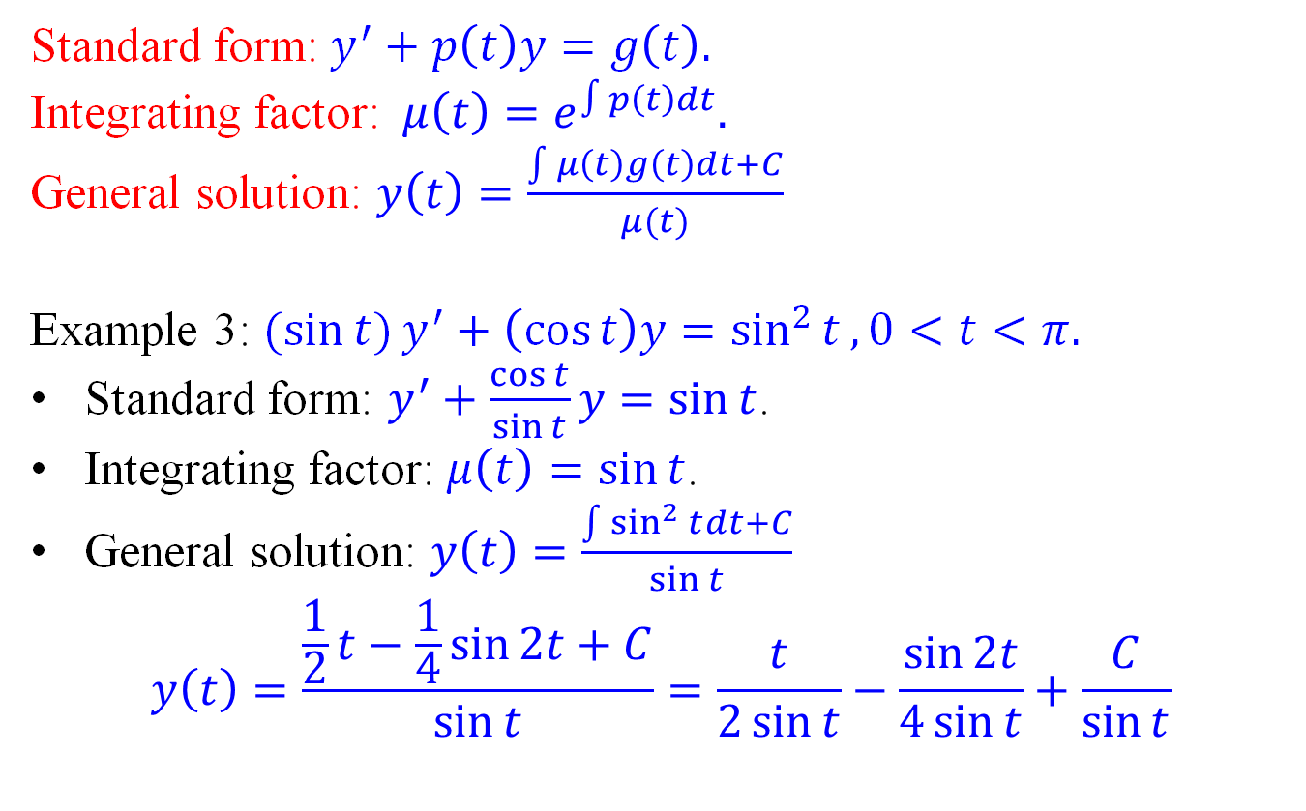
First-order linear ODEs - Example 3
Standard form:$y^{′}+p\left(t\right)y=g\left(t\right).$
Integrating factor: $μ\left(t\right)=e^{∫p\left(t\right)dt}.$
General solution: $y\left(t\right)=\frac{\int{μ\left(t\right)g\left(t\right)dt}+C}{μ(t)}$
Example 3: ${(sin{t)}y}^{′}+\left(\cos{t}\right)y=\sin^{2}{t}, 0<t<π.$
Standard form: $y^{′}+\frac{\cos{t}}{\sin{t}}y=\sin{t}$.
Integrating factor: $μ\left(t\right)=\sin{t}$.
General solution: $y\left(t\right)=\frac{\int{\sin^{2}{t}dt}+C}{\sin{t}}$
$$y\left(t\right)=\frac{\frac{1}{2}t−\frac{1}{4}\sin{2t}+C}{\sin{t}}=\frac{t}{2\sin{t}}−\frac{\sin{2t}}{4\sin{t}}+\frac{C}{\sin{t}}$$
May simplify as $\frac{2\sin{t\cos{t}}}{4\sin{t}}=\frac{\cos{t}}{2}$

